Slide 1
Fraud Detection in Fastag Transactions
Machine Learning Internship Project

Slide 2
Introduction
Objective: Develop a machine learning model to detect fraudulent Fastag transactions.
Importance: Ensures security and integrity of digital toll transactions.
Dataset Overview
Transaction_ID
Timestamp
Vehicle_Type
FastagID
TollBoothID
Lane_Type
Vehicle_Dimensions
Transaction_Amount, Amount_paid
Geographical_Location
Vehicle_Speed
Vehicle_Plate_Number
Fraud_indicator (Target variable)

Slide 3
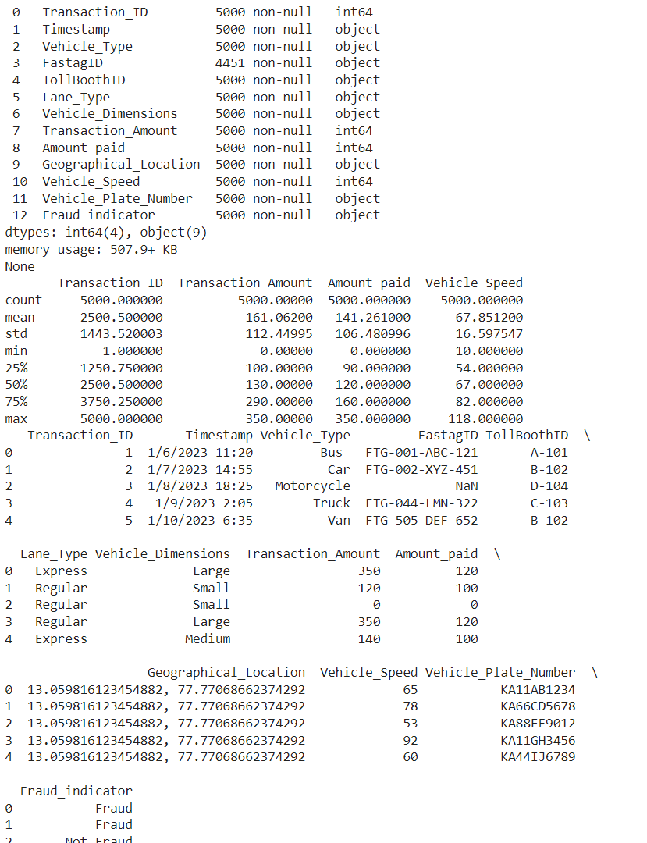
Output
Dataset Overview
Load the dataset and inspect its structure.
Use Python libraries like pandas to load and inspect the dataset.
Use info(), describe(), and head() methods for initial inspection.
Use describe() for numerical data.
Use value_counts() for categorical data.

Slide 4
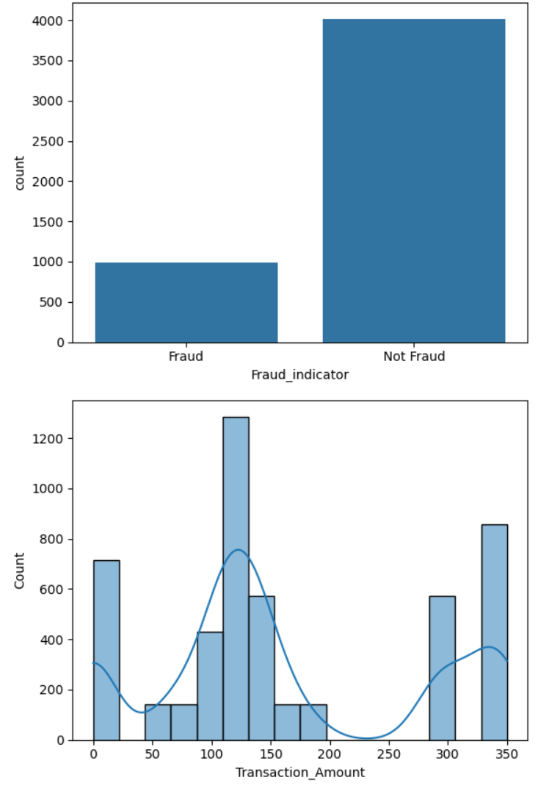
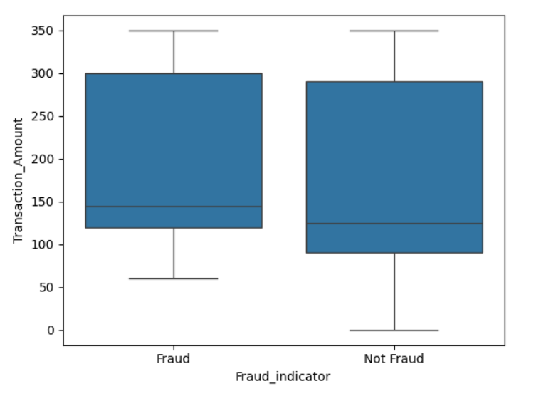
Visualize Data
Use libraries like matplotlib, seaborn, and plotly for creating plots (histograms, box plots, bar charts).

Slide 5
Model Development
Objective: Build a machine learning classification model to predict and detect Fastag transaction fraud.
Tasks:
Split Data: Split the dataset into training and testing sets.
Use train_test_split from sklearn.
Choose Algorithms: Train different classification models.
Start with basic models like Logistic Regression and Decision Trees.
Experiment with more complex models like Random Forest, Gradient Boosting, and XGBoost.
Output

Slide 6
Model Evaluation
Objective: Evaluate and fine-tune model performance using appropriate metrics.
Tasks:
Evaluate Models: Calculate evaluation metrics such as precision, recall, F1 score, and accuracy.
Use precision_score, recall_score, f1_score, and accuracy_score from sklearn.metrics.
Compare Models: Compare the performance of different models and select the best-performing one.
Hyperparameter Tuning: Fine-tune the hyperparameters of the best model.
Use GridSearchCV or RandomizedSearchCV from sklearn.

Slide 7
Tools and Technologies
Python: Programming language.
Libraries: pandas, numpy, matplotlib, seaborn, scikit-learn, imbalanced-learn, flask, fastapi, joblib.
Development Environment: Jupyter Notebook, any Python IDE or Google colab.
Google colab : https://colab.research.google.com/
For more details :
https://colab.research.google.com/drive/1uJMmpgV32p3BJFOBsc5Vu1eD4bzgEJer
Dataset

